Slide 1
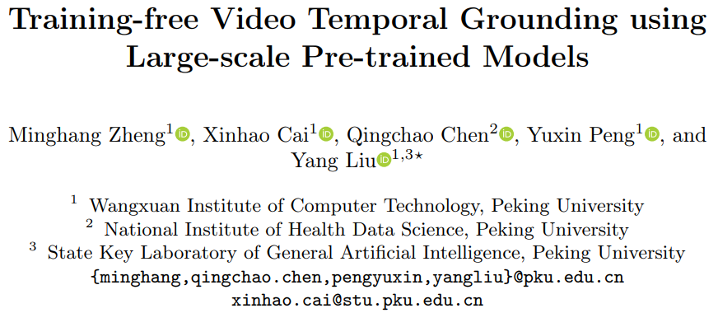
Presenter : 김진용

Slide 2
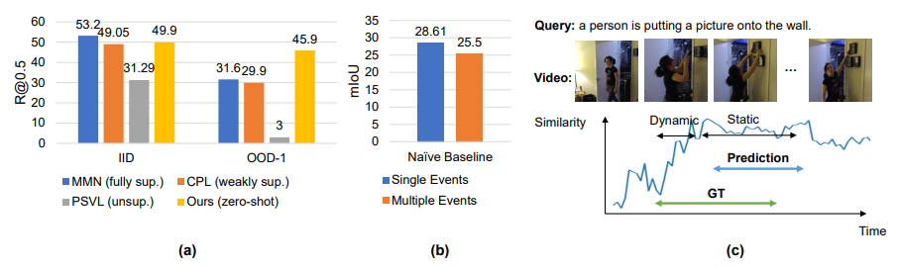
Introduction
Contribution
We propose a training free pipeline for video temporal grounding using LLM and VLMs.
To help VLM better understand the dynamic transitions in the video, we divide the events into dynamic and static parts and model them separately.
Our method achieves the best performance on zero-shot temporal grounding on both the Charades-STA and Activity Net Captions datasets and has a greater advantage in cross-dataset and OOD settings.

Slide 3
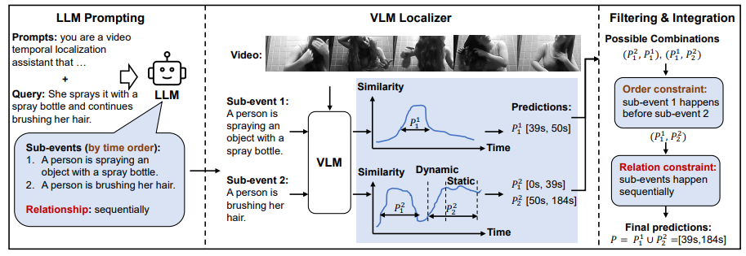
Method

Slide 4
Method
What does LLM do for VTG?
LLM analyze events in user’s query and divide the events into sub-events.
Infer order and relationships of the sub-events.
Example)
Order : A->B
Relationships : single, sequentially, simultaneously

Slide 5

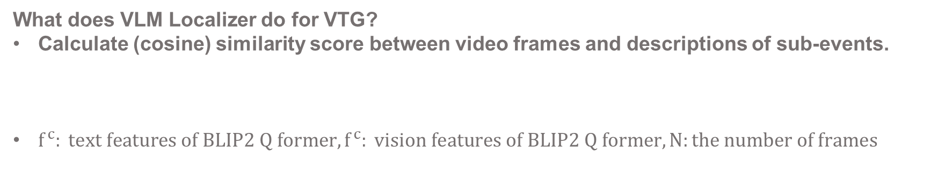
Method
What does VLM Localizer do for VTG?
Calculate (cosine) similarity score between video frames and descriptions of sub-events.
$f^{c}: text features of BLIP2 Q former, f^{c}: vision features of BLIP2 Q former, N:the number of frames$

Slide 6
Method
What does VLM Localizer do for VTG?
Calculate (cosine) similarity score between video frames and descriptions of sub-events.
Classify Static and Dynamic segments.
Localizer can’t response sensitively during dynamic transitions.
For example, in given query “A person sits down“, localizer tends to predict segments where the person is already seated on the chair rather than the process of the person gradually from standing up to sitting down.

Slide 7

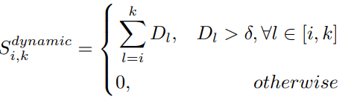


Method
Dynamic : increasing
Static : high score average
${D =S}_{i} - S_{i-1}, k:end stamptime of dynamic, i: start stamptime of dynamic$
If score differential is over than threshold, the range is designated to dynamic segment.
Dynamic score is defined to sum of score differential values in dynamic segement.
$k:end stamptime of dynamic, i: start stamptime of dynamic, j: end stamptime of static$
Static score is defined to subtraction of sum of score differential values in static segment and sum of score differential values not in static segment.
“j” is determined by maximizing sum of dynamic score and static score.

Slide 8

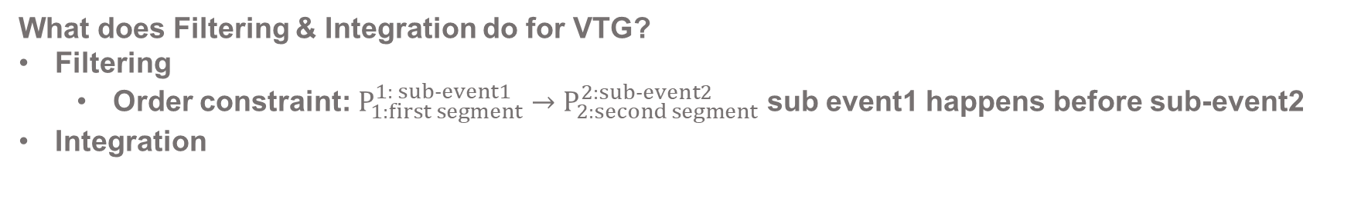
Method
What does Filtering & Integration do for VTG?
Filtering
Order constraint: $P_{1:first segment}^{1: sub-event1}→P_{2:second segment}^{2:sub-event2}$ sub event1 happens before sub-event2
Integration

Slide 9
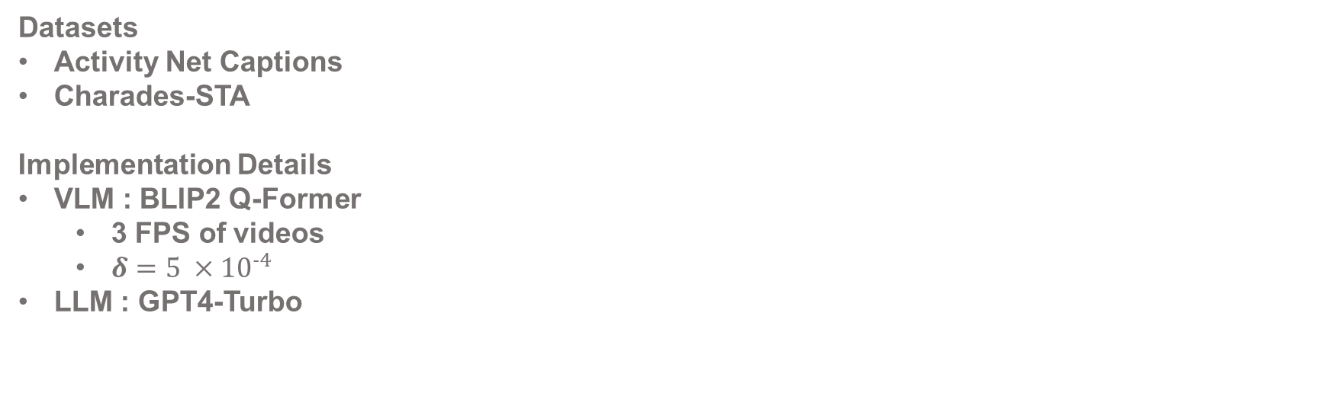
Experiments
Datasets
Activity Net Captions
Charades-STA
Implementation Details
VLM : BLIP2 Q-Former
3 FPS of videos
$δ={5 ×10}^{-4}$
LLM : GPT4-Turbo

Slide 10
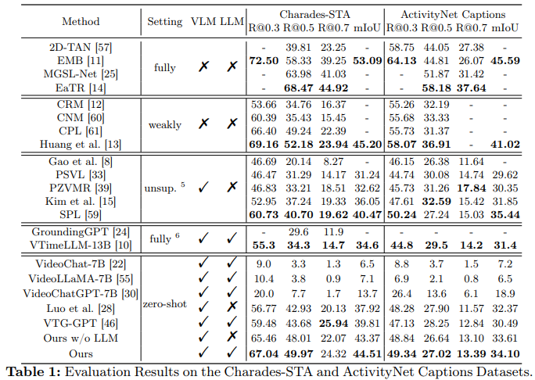
Experiments

Slide 11
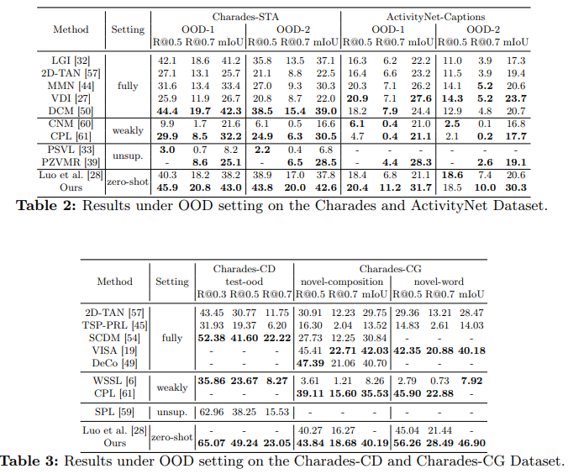
Experiments
Inserting a segment of random generated video at the beginning of test videos.

Slide 12
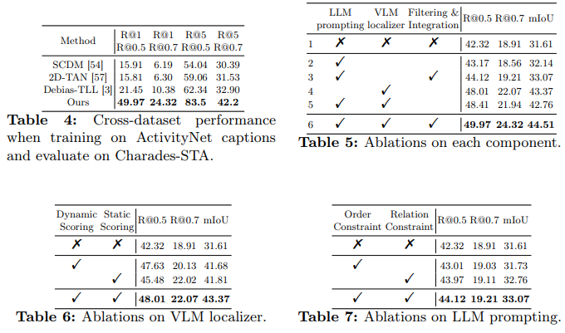
Experiments
Ablation Study

Slide 13
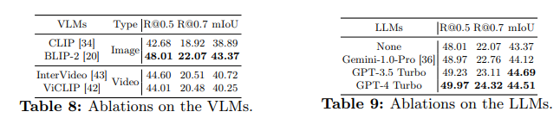
Experiments
Ablation Study

